Slide 1

Microsoft Teams User Group Berlin
26. Oktober 2023
Meetup #27

Slide 2

https://spirit21.com

Slide 3

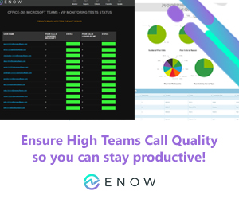
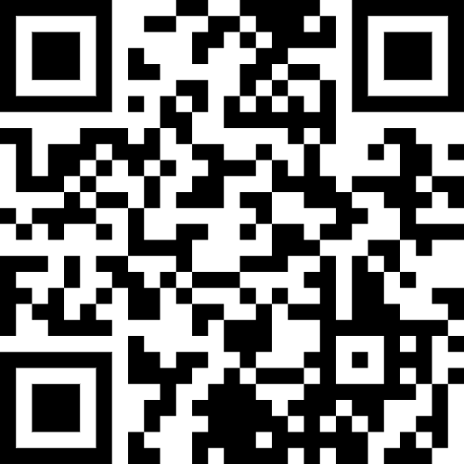
https://www.enowsoftware.com

Slide 4

Agenda
18:00 - 18:15 | Landing Zone
18:15 - 19:00 | Content-Migration nach SharePoint und Teams Hanna Kostrewa und Stefan Esch
19:15 - 19:45 | Microsoft Teams Neuigkeiten Thomas Stensitzki (@stensitzki)
19:45 -20:30 | Offene Teams Sprechstunde
 | Organisatorisches
Dieses Meeting wird aufgezeichnet und online auf YouTube bereitgestellt. This meeting will be recorded and made available online.

Slide 5
Content-Migration nach SharePoint und Teams
Hanna Kostrewa und Stefan Esch

Slide 6
Neues in Microsoft Teams Ankündigungen & Rollouts
Updates
Meetup #27 Thomas Stensitzki

Slide 7
Neuigkeiten in Microsoft Teams
New Microsoft Teams rollout schedule, new controls, and direct deployment
Addition of Chat button in Missed Call Activity
New Call Shortcuts in New Teams
Engagement Information in Teams Attendance Report (Premium)
Emojis, GIFs and Stickers Unified in One Picker
Loop components in Channels and Loop Embed Mode in Teams
Intelligent Recap Support for Additional Languages (Premium)

Slide 8
New Microsoft Teams rollout schedule, new controls, and direct deployment
Neuer Teams-Zeitplan für Kunden
Updatekanal | Datum
Öffentliches Vorschauprogramm | Verfügbar
Gezieltes Releaseprogramm | Verfügbar
Aktueller Kanal | Im Rollout
Government Cloud (GCC, GCC High) Preview | Oktober 2023
Government Cloud (DoD) Preview | Mitte Oktober 2023
Monatlicher Enterprise-Kanal | Ende Oktober 2023
Semi-Annual Enterprise-Kanal (Vorschau) | Oktober 2023
Semi-Annual Enterprise Channel, Halbjährlicher Erweiterter Kanal, LTSC und verbleibende Kanäle | November 2023

Slide 9
Neuigkeiten in Microsoft Teams
New Microsoft Teams rollout schedule, new controls, and direct deployment
Addition of Chat button in Missed Call Activity
New Call Shortcuts in New Teams
Engagement Information in Teams Attendance Report (Premium)
Emojis, GIFs and Stickers Unified in One Picker
Loop components in Channels and Loop Embed Mode in Teams
Intelligent Recap Support for Additional Languages (Premium)

Slide 10
Addition of Chat button in Missed Call Activity
Zusätzliche Schaltfläche "Chat" bei einem verpassten Teams-Anruf
Keine Einstellungsoptionen
Rollout ab November

Slide 11
Neuigkeiten in Microsoft Teams
New Microsoft Teams rollout schedule, new controls, and direct deployment
Addition of Chat button in Missed Call Activity
New Call Shortcuts in New Teams
Engagement Information in Teams Attendance Report (Premium)
Emojis, GIFs and Stickers Unified in One Picker
Loop components in Channels and Loop Embed Mode in Teams
Intelligent Recap Support for Additional Languages (Premium)

Slide 12
New Call Shortcuts in New Teams
Windows
Alt + Shift + A to initiate audio calls
Alt + Shift + V for video calls.
MacOs
Option + Shift + A to initiate audio calls
Option + Shift + V for video calls.

Slide 13
Neuigkeiten in Microsoft Teams
New Microsoft Teams rollout schedule, new controls, and direct deployment
Addition of Chat button in Missed Call Activity
New Call Shortcuts in New Teams
Engagement Information in Teams Attendance Report (Premium)
Emojis, GIFs and Stickers Unified in One Picker
Loop components in Channels and Loop Embed Mode in Teams
Intelligent Recap Support for Additional Languages (Premium)

Slide 14
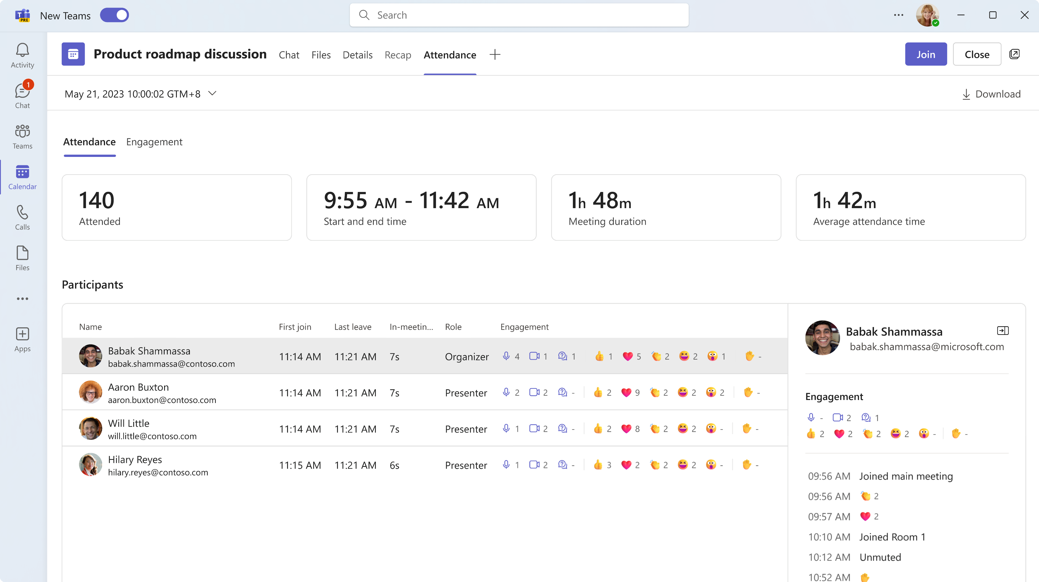
Engagement Information in Teams Attendance Report (Premium)
Teams Einstellungen- und Richtlinien

Slide 15
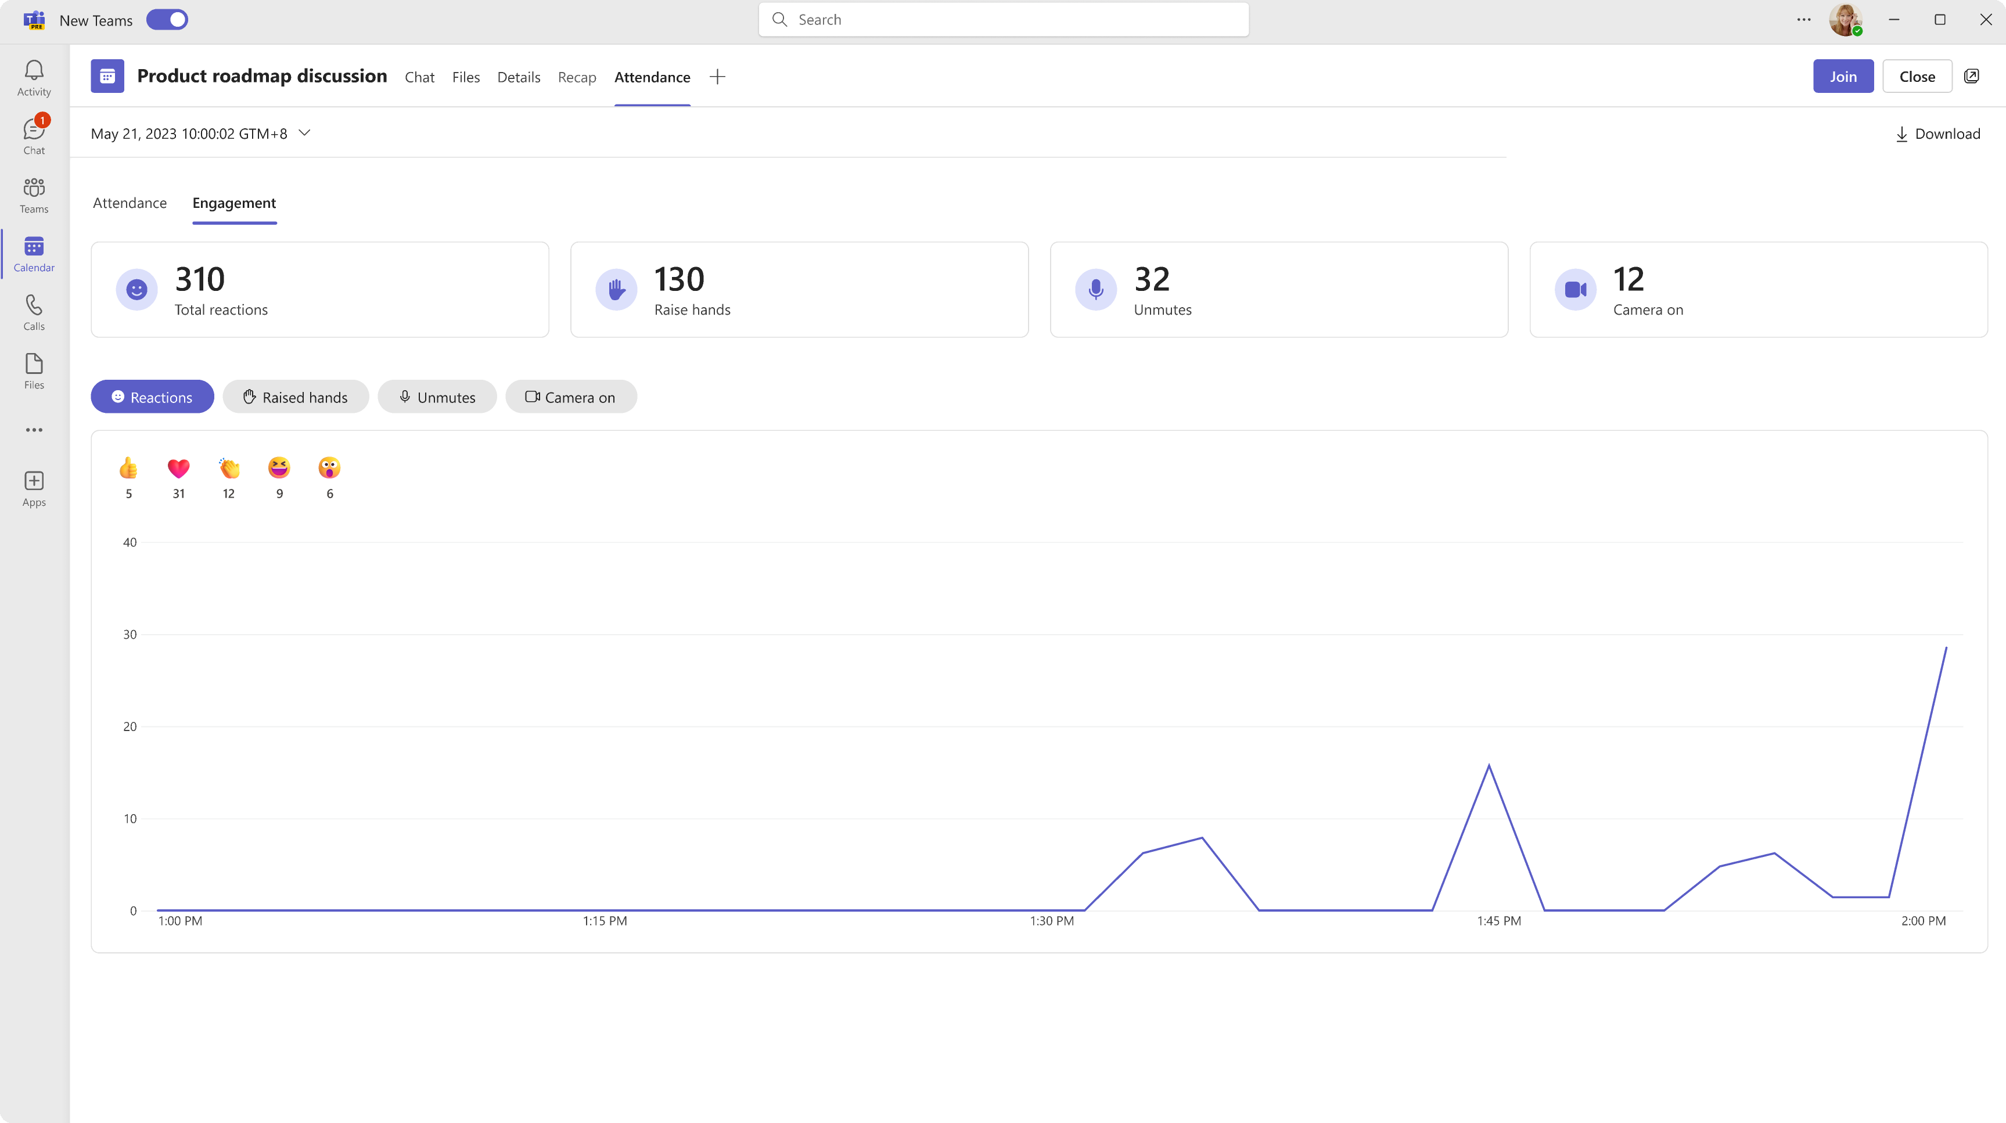
Engagement Information in Teams Attendance Report (Premium)
Teams Einstellungen- und Richtlinien

Slide 16
Neuigkeiten in Microsoft Teams
New Microsoft Teams rollout schedule, new controls, and direct deployment
Addition of Chat button in Missed Call Activity
New Call Shortcuts in New Teams
Engagement Information in Teams Attendance Report (Premium)
Emojis, GIFs and Stickers Unified in One Picker
Loop components in Channels and Loop Embed Mode in Teams
Intelligent Recap Support for Additional Languages (Premium)

Slide 17
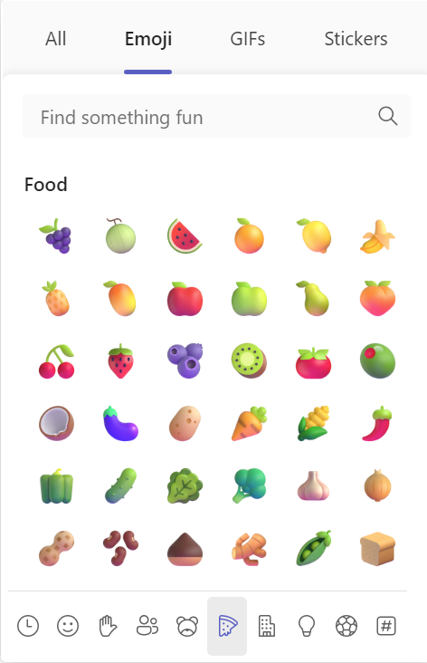
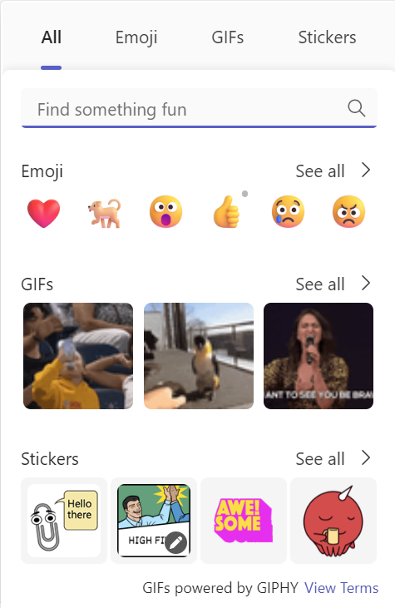
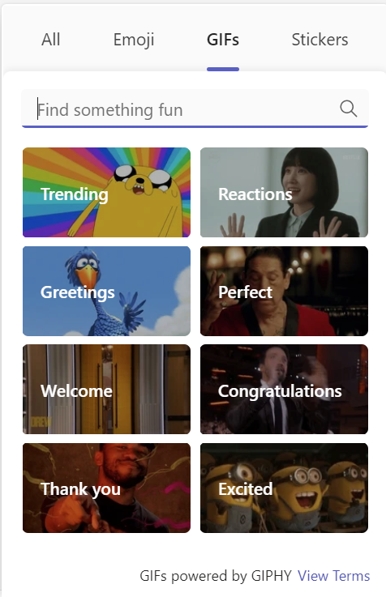
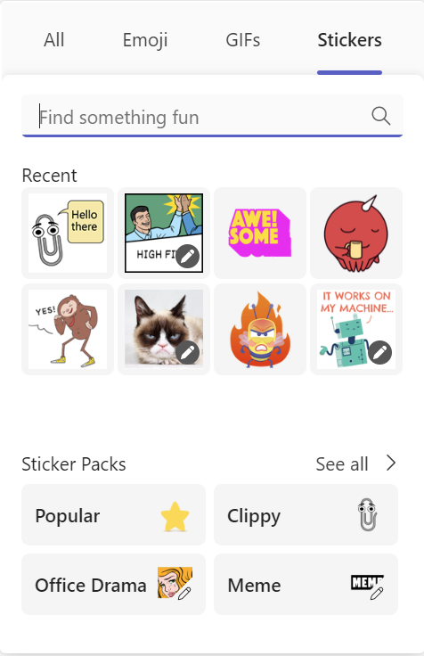
Emojis, GIFs and Stickers Unified in One Picker

Slide 18
Neuigkeiten in Microsoft Teams
New Microsoft Teams rollout schedule, new controls, and direct deployment
Addition of Chat button in Missed Call Activity
New Call Shortcuts in New Teams
Engagement Information in Teams Attendance Report (Premium)
Emojis, GIFs and Stickers Unified in One Picker
Loop components in Channels and Loop Embed Mode in Teams
Intelligent Recap Support for Additional Languages (Premium)

Slide 19
Loop components in Channels and Loop Embed Mode in Teams
Loop in Channels ist verfügbar für alle Kanaltypen
Standard, Privat und Geteilt
Copy & Paste zwischen Kanälen, Chats, Outlook E-Mails und anderen unterstützten Microsoft 365 Apps
Erstellung von Loop-Komponenten
Desktop oder Web
Unterstützung
Ansicht in iOS und iPadOS
Android → Link zur Loop-Webseite

Slide 20
Neuigkeiten in Microsoft Teams
New Microsoft Teams rollout schedule, new controls, and direct deployment
Addition of Chat button in Missed Call Activity
New Call Shortcuts in New Teams
Engagement Information in Teams Attendance Report (Premium)
Emojis, GIFs and Stickers Unified in One Picker
Loop components in Channels and Loop Embed Mode in Teams
Intelligent Recap Support for Additional Languages (Premium)

Slide 21
Intelligent Recap Support for Additional Languages (Premium)
AI-Funktionen für die intelligente Besprechungs-zusammenfassung sind für folgende Sprachen verfügbar
Chinese Simplified, French, German, Italian, Japanese, Spanish, and Portuguese
Voraussetzung:
Aufzeichnung und Transkription der Besprechung
AI-Notizen und Aufgaben werden in der Sprache der Besprechung bereitgestellt

Slide 22
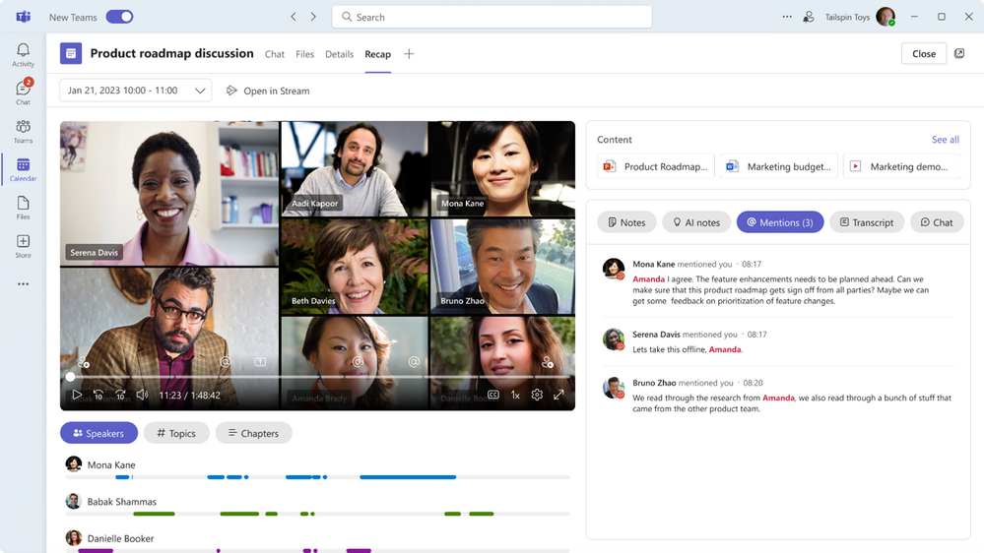
Intelligent Recap Support for Additional Languages (Premium)

Slide 23
Neuigkeiten in Microsoft Teams
Set 'Out of Office' from Teams Mobile Application

Slide 24
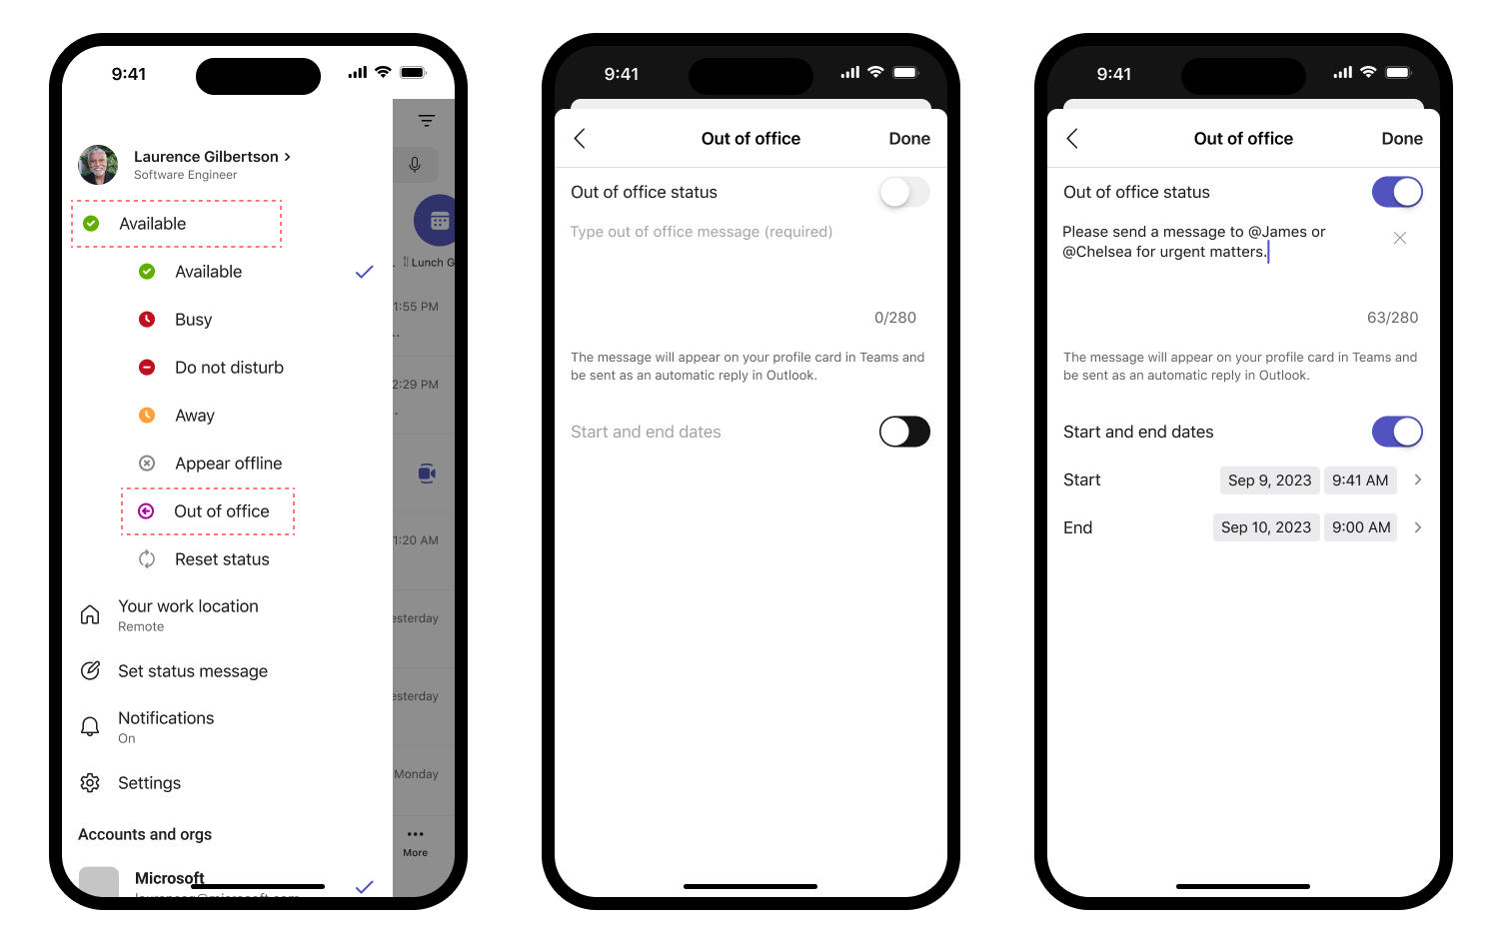

Set 'Out of Office' from Teams Mobile Application
Nur-Text Eingabe
Kein HTML
Überschreibt Outlook OOF

Slide 25
Neues in Microsoft Teams Ankündigungen & Rollouts für Admins
Updates
Meetup #27 Thomas Stensitzki

Slide 26
Neuigkeiten in Microsoft Teams für Admins
Microsoft Teams Rooms Pro Management Improved Search for rooms
Watermark support for recording playback (Premium) → Ende Nov
Front Row Enhancement: Active video speaker promotion for Teams Rooms on Windows
Support Joining a Teams Live Event as Attendee for Teams Rooms on Windows
macOS name change: Microsoft Teams to Microsoft Teams classic MDM Impact
Extended Real-time Telemetry Retention Up To Seven Days

Slide 27
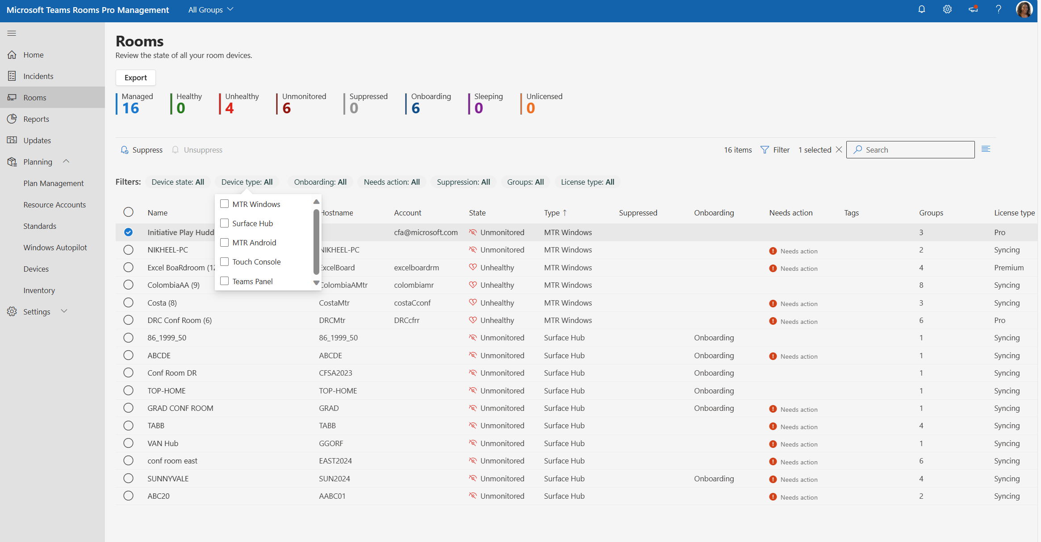
Microsoft Teams Rooms Pro Management Improved Search for rooms
https://portal.rooms.microsoft.com → Mindestens eine Teams Rooms Pro Lizenz
Teams Rooms Pro Management - Dokumentation

Slide 28
Neuigkeiten in Microsoft Teams für Admins
Microsoft Teams Rooms Pro Management Improved Search for rooms
Watermark support for recording playback (Premium) → Ende Nov
Front Row Enhancement: Active video speaker promotion for Teams Rooms on Windows
Support Joining a Teams Live Event as Attendee for Teams Rooms on Windows
macOS name change: Microsoft Teams to Microsoft Teams classic MDM Impact
Extended Real-time Telemetry Retention Up To Seven Days

Slide 29
Neuigkeiten in Microsoft Teams für Admins
Microsoft Teams Rooms Pro Management Improved Search for rooms
Watermark support for recording playback (Premium) → Ende Nov
Front Row Enhancement: Active video speaker promotion for Teams Rooms on Windows
Support Joining a Teams Live Event as Attendee for Teams Rooms on Windows
macOS name change: Microsoft Teams to Microsoft Teams classic MDM Impact
Extended Real-time Telemetry Retention Up To Seven Days

Slide 30
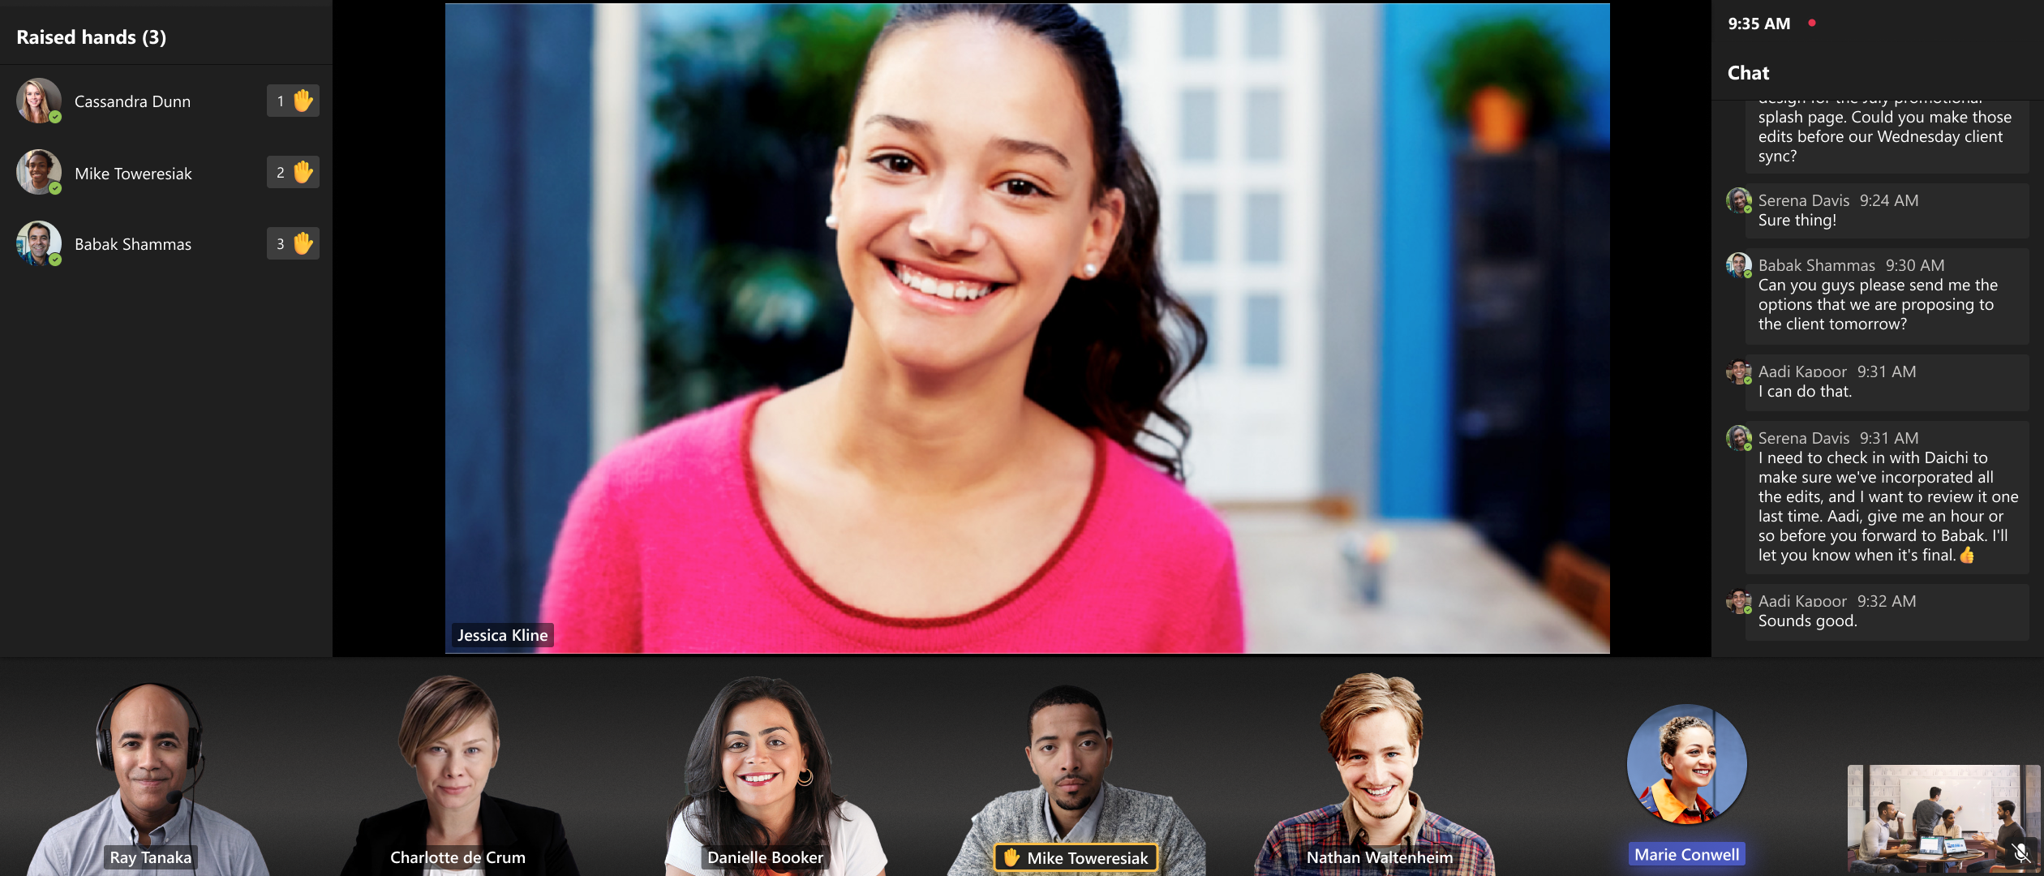
Front Row Enhancement: Active video speaker promotion for Teams Rooms on Windows
Notes:
The Front Row layout is improved to promote pinned or spotlighted participants to the center stage when there is no shared content in the meeting. This addresses customer feedback on empty space utilization and aligns pinned or spotlighted participants treatment across single and dual front of room displays. Additionally, active speaker video is promoted to the center stage to utilize display to create immersive experience for in room users. For single display configurations, when no one is pinned, spotlighted or sharing content, the most recent active speaker video will be promoted to the center. In dual display mode, when no one is pinned, spotlighted or sharing content, two most recent active speaker videos are promoted to the center on each screen. When someone is sharing content in the meeting, it’s displayed on one display while the other display shows the most recent active video speaker.

Slide 31
Neuigkeiten in Microsoft Teams für Admins
Microsoft Teams Rooms Pro Management Improved Search for rooms
Watermark support for recording playback (Premium) → Ende Nov
Front Row Enhancement: Active video speaker promotion for Teams Rooms on Windows
Support Joining a Teams Live Event as Attendee for Teams Rooms on Windows
macOS name change: Microsoft Teams to Microsoft Teams classic MDM Impact
Extended Real-time Telemetry Retention Up To Seven Days

Slide 32
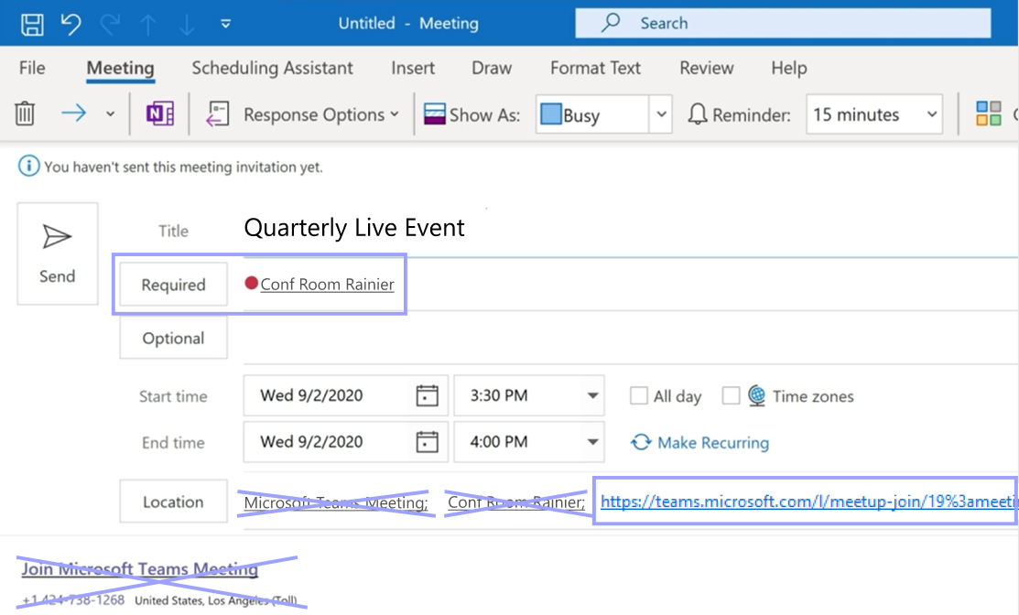
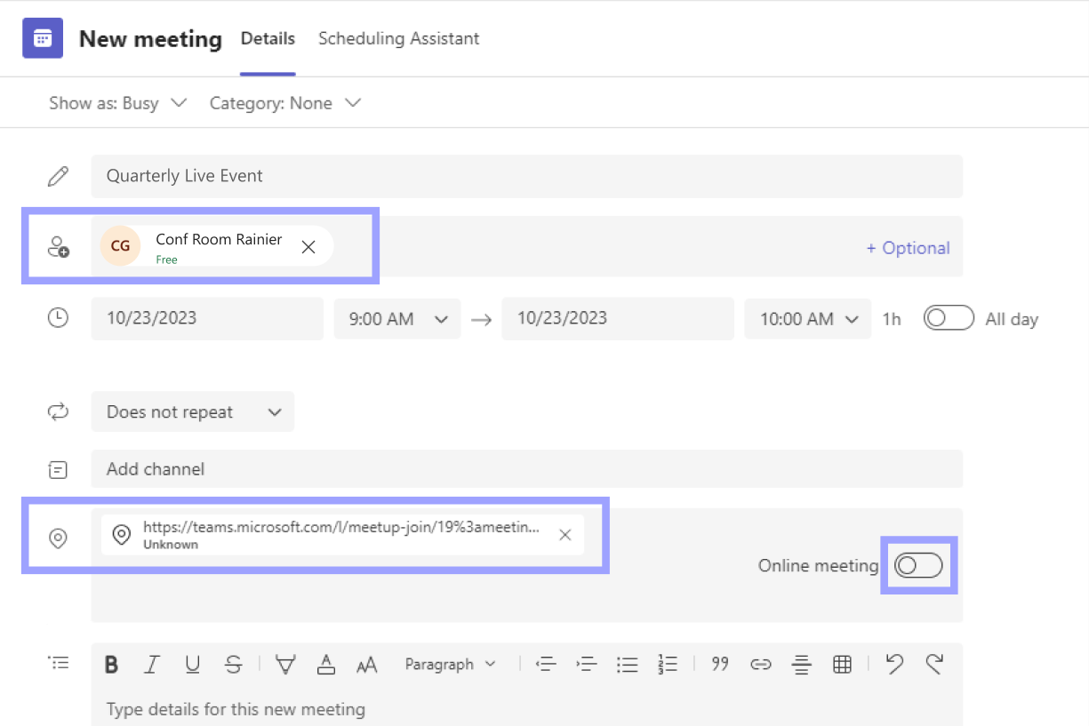
Support Joining a Teams Live Event as Attendee for Teams Rooms on Windows
Teams Rooms on Windows App 4.19 update includes the support joining a Teams live event as an attendee

Slide 33
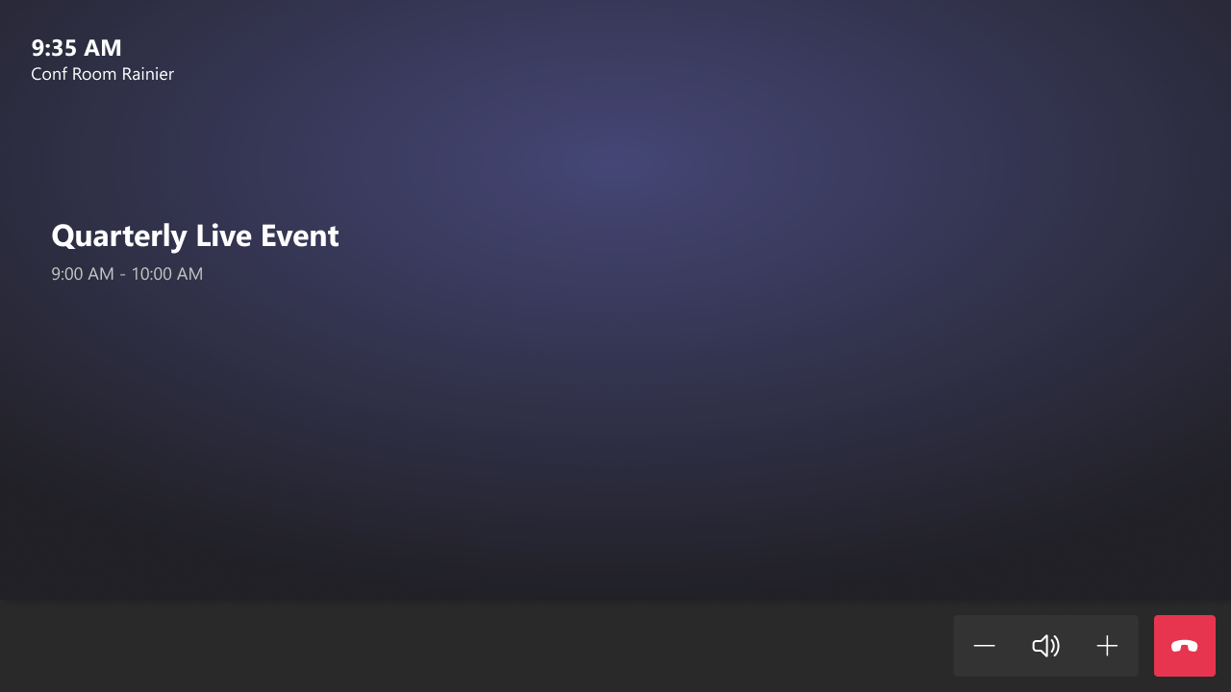
Support Joining a Teams Live Event as Attendee for Teams Rooms on Windows

Slide 34
Neuigkeiten in Microsoft Teams für Admins
Microsoft Teams Rooms Pro Management Improved Search for rooms
Watermark support for recording playback (Premium) → Ende Nov
Front Row Enhancement: Active video speaker promotion for Teams Rooms on Windows
Support Joining a Teams Live Event as Attendee for Teams Rooms on Windows
macOS name change: Microsoft Teams to Microsoft Teams classic MDM Impact
Extended Real-time Telemetry Retention Up To Seven Days

Slide 35
macOS name change: Microsoft Teams to Microsoft Teams classic MDM Impact
Bundle IDs for new and classic Teams remain the same
The bundle ID for Microsoft Teams classic remains the same → com.microsoft.teams
The bundle ID for Microsoft Teams (work or school) is → com.microsoft.teams2
Note: This is the same bundle ID for the preview version which was named Microsoft Teams (work preview)

Slide 36
macOS name change: Microsoft Teams to Microsoft Teams classic MDM Impact
MacOS .app file name changes with the recent GA of new Teams
Microsoft Teams classic-- formerly Microsoft Teams Changed from Microsoft Teams.app to → Microsoft Teams classic.app
New Teams-- now officially Microsoft Teams (work or school)
Changed from Microsoft Teams (work preview).app to → Microsoft Teams (work or school).app
Latest Teams Classic Build: https://go.microsoft.com/fwlink/?linkid=869428 Latest New Teams GA Build: https://go.microsoft.com/fwlink/?linkid=2249065

Slide 37
Neuigkeiten in Microsoft Teams für Admins
Microsoft Teams Rooms Pro Management Improved Search for rooms
Watermark support for recording playback (Premium) → Ende Nov
Front Row Enhancement: Active video speaker promotion for Teams Rooms on Windows
Support Joining a Teams Live Event as Attendee for Teams Rooms on Windows
macOS name change: Microsoft Teams to Microsoft Teams classic MDM Impact
Extended Real-time Telemetry Retention Up To Seven Days

Slide 38
Extended Real-time Telemetry Retention Up To Seven Days
Verwenden von Echtzeit-Telemetrie zur Problembehandlung bei schlechter Besprechungsqualität
Szenario | Aktuelles Verhalten (Public Preview) | Neues Verhalten ab GA
 |  | Besprechungsteilnehmer mit Teams Premium | Besprechungsteilnehmer ohne Teams Premium
Admin hat keine Echtzeit-Telemetrie im TAC aktiviert | 0 Tage | 7 Tage | 0 Tage
Admin hat Echtzeit-Telemetrie für aktive Besprechungen im TAC aktiviert | 7 Tage | 7 Tage | 1 Tag

Slide 39
Neuigkeiten in Microsoft Teams für Admins
Ratings and Reviews for Apps on Teams now Available
Bring-Your-Own-Device IT Admin Experience in Teams Pro Management Portal
Advanced Collaboration Analytics (Premium)
Webinar Email feature updates -customize content and time to send reminders (Premium)

Slide 40
Ratings and Reviews for Apps on Teams now Available
Anwender können Feedback von anderen Kunden zu einer Teams App sehen und selbst Feedback geben
App-Publisher können auf das Feedback reagieren
Basiert auf: Microsoft AppSource Ratings Service
Komponente der Connected Experience
Übersicht über die optionalen verbundenen Erfahrungen in Microsoft Teams

Slide 41
Neuigkeiten in Microsoft Teams für Admins
Ratings and Reviews for Apps on Teams now Available
Bring-Your-Own-Device IT Admin Experience in Teams Pro Management Portal
Advanced Collaboration Analytics (Premium)
Webinar Email feature updates -customize content and time to send reminders (Premium)

Slide 42
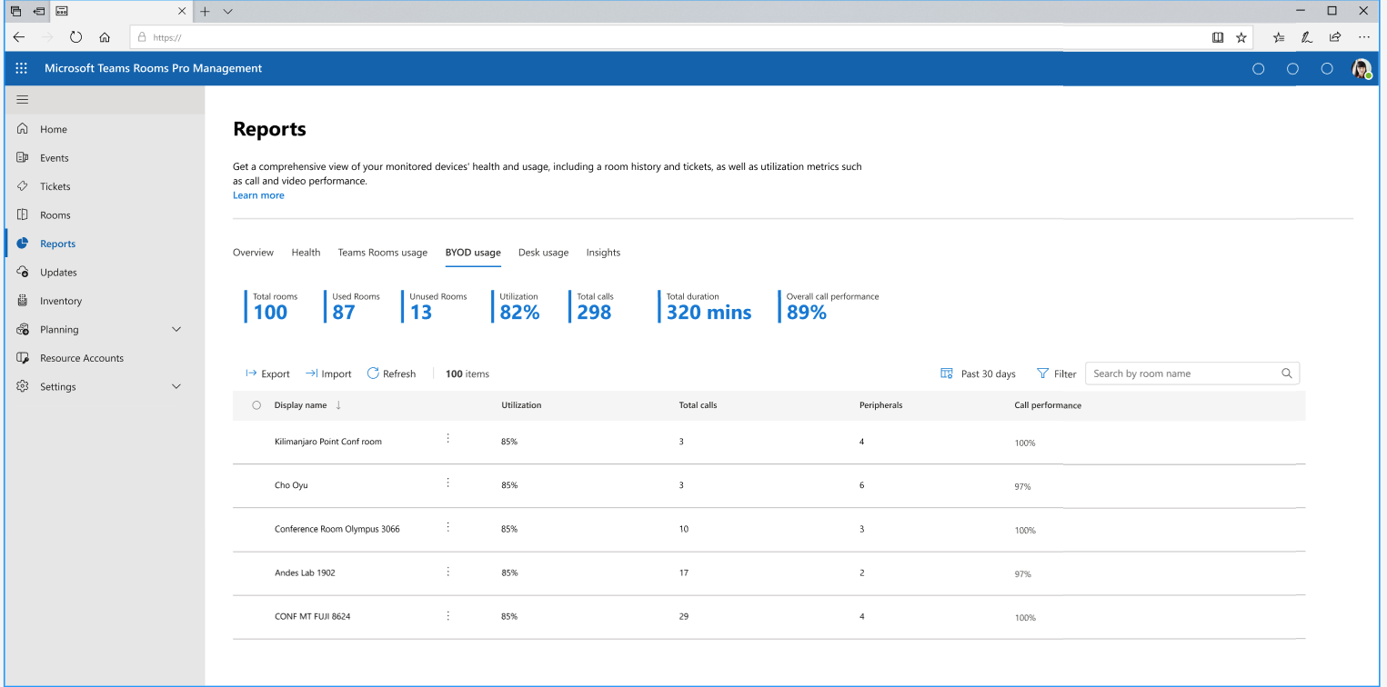
Bring-Your-Own-Device IT Admin Experience in Teams Pro Management Portal

Slide 43
Neuigkeiten in Microsoft Teams für Admins
Ratings and Reviews for Apps on Teams now Available
Bring-Your-Own-Device IT Admin Experience in Teams Pro Management Portal
Advanced Collaboration Analytics (Premium)
Webinar Email feature updates -customize content and time to send reminders (Premium)

Slide 44
Advanced Collaboration Analytics
Erweitere Auswertungsfunktion im TAC
List of inactive teams
List of inactive domains
List of users with most external collaboration
List of teams with most external collaboration
List of guests with most external collaboration
Channel breakdown by type
Team breakdown by user type

Slide 45
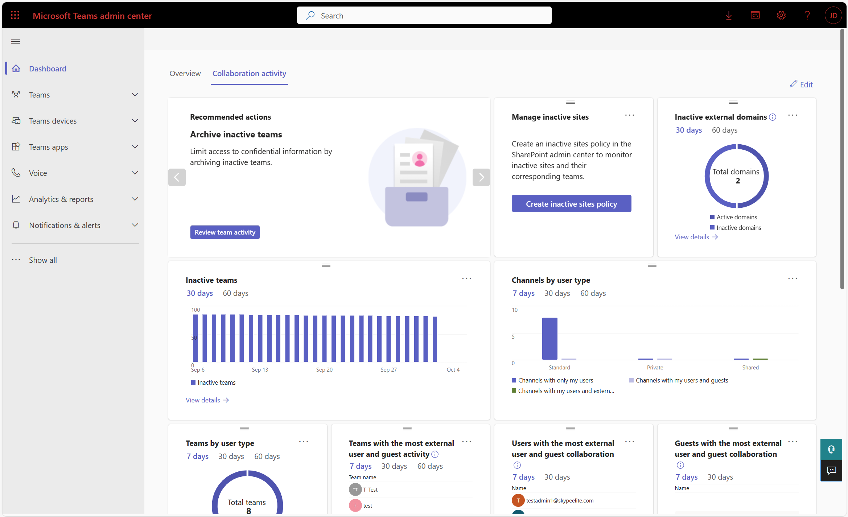
Advanced Collaboration Analytics

Slide 46
Neuigkeiten in Microsoft Teams für Admins
Ratings and Reviews for Apps on Teams now Available
Bring-Your-Own-Device IT Admin Experience in Teams Pro Management Portal
Advanced Collaboration Analytics (Premium)
Webinar Email feature updates -customize content and time to send reminders (Premium)

Slide 47
Webinar Email feature updates -customize content and time to send reminders
The content of the emails (i.e. all webinar related attendee emails) can be edited by the event organizers. This is reserved for Teams Premium licensed organizers.
Time to send reminder emails can be configured by the event organizers. This is reserved for Teams Premium licensed organizers.

Slide 48
Offene Teams Sprechstunde

Slide 49
Themen
Green screen feature in Teams Meetings [MC529415]
Avatars: Hardware Requirements and Service Plan Update [MC678301]
Introducing Microsoft Teams Town hall [MC678002]

Slide 50
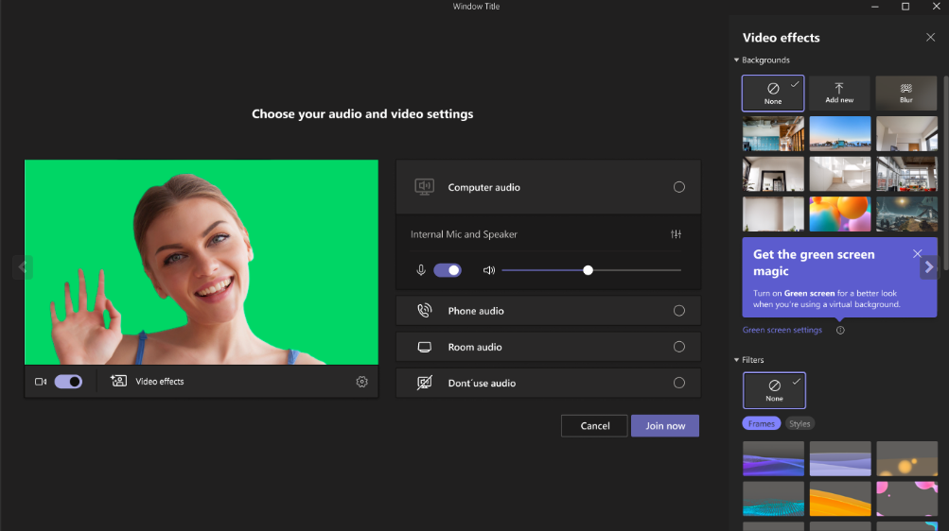
Green screen feature in Teams Meetings

Slide 51
Green screen feature in Teams Meetings
Unterstützung für Windows und macOS Geräte mit Intel (und AMD) Chipsets
Mac M1/M2 are not supported.
Automatische Deaktivierung von Background Blur und Together Mode
Kompatibel mit Presenter Modi Standout, Side-by-Side, Reporter und PowerPoint Live Standout und ausgewechseltem Hintergrund (JPEG/PNG).
Transparente und durchscheinende Objekte führen zu keinem guten Ergebnis
Zu dünne Objekte werden nicht korrekt erkannt

Slide 52
Avatars: Hardware Requirements and Service Plan Update
Updated October 4, 2023: IT admins have been previously informed that there will be a new service plan in your Microsoft 365 or Office 365 licenses: MESH_AVATARS_FOR_TEAMS. You may have also noticed that there is an additional service plan MESH_AVATARS_ADDITIONAL_FOR_TEAMS that was published alongside the MESH_AVATARS_FOR_TEAMS service plan. Here are the intended uses of the two service plans:
MESH_AVATARS_FOR_TEAMS – this service plan enables or disables Mesh Avatars for Teams. MESH_AVATARS_ADDITIONAL_FOR_TEAMS – this service plan is intended to differentiate any features that may be released separately between commercial and non-commercial customers due to different legal requirements Please be mindful that there are currently no features in MESH_AVATARS_ADDITIONAL_FOR_TEAMS at this time so there are no actions needed. We will let you know when any features are added to this service plan.
----Original message below--- You will soon see a new service plan associated with your Microsoft 365 or Office 365 license: Avatars for Teams (MESH_AVATARS_FOR_TEAMS). Avatars for Teams app is also updating the minimum hardware requirements to access this feature. The new minimum specified hardware requirement is a two core CPU with 6gb RAM. Users will not be able to utilize this feature if it does not meet the minimum hardware spec. This change is due to be able to provide users with a better Avatars for Teams experience.
Notes:
MC672518 - (Updated) Avatars: Hardware Requirements and Service Plan Update (jcteams.info)

Slide 53
Introducing Microsoft Teams Town hall
Ersatz für Live Events
Notes:
MC678002 - Introducing Microsoft Teams Town hall | cloudscout.one

Slide 55
Microsoft Teams – Links
What’s New in Microsoft Teams | September 2023
What’s New in Microsoft Teams for Education | October 2023
Microsoft Teams Blog
Microsoft Teams Community Blog
Microsoft Teams Feedback Portal

Slide 56
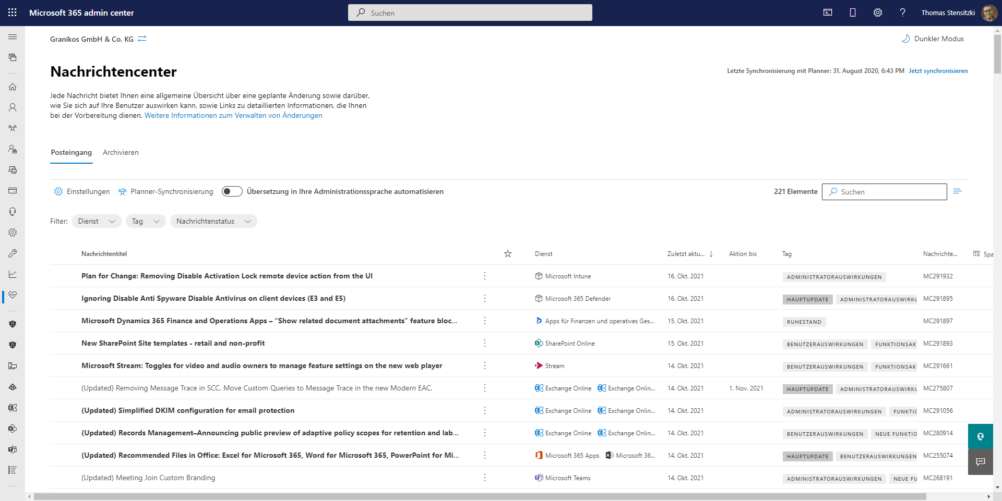
https://admin.microsoft.com/#/MessageCenter

Slide 57
Organisatorisches

Slide 58
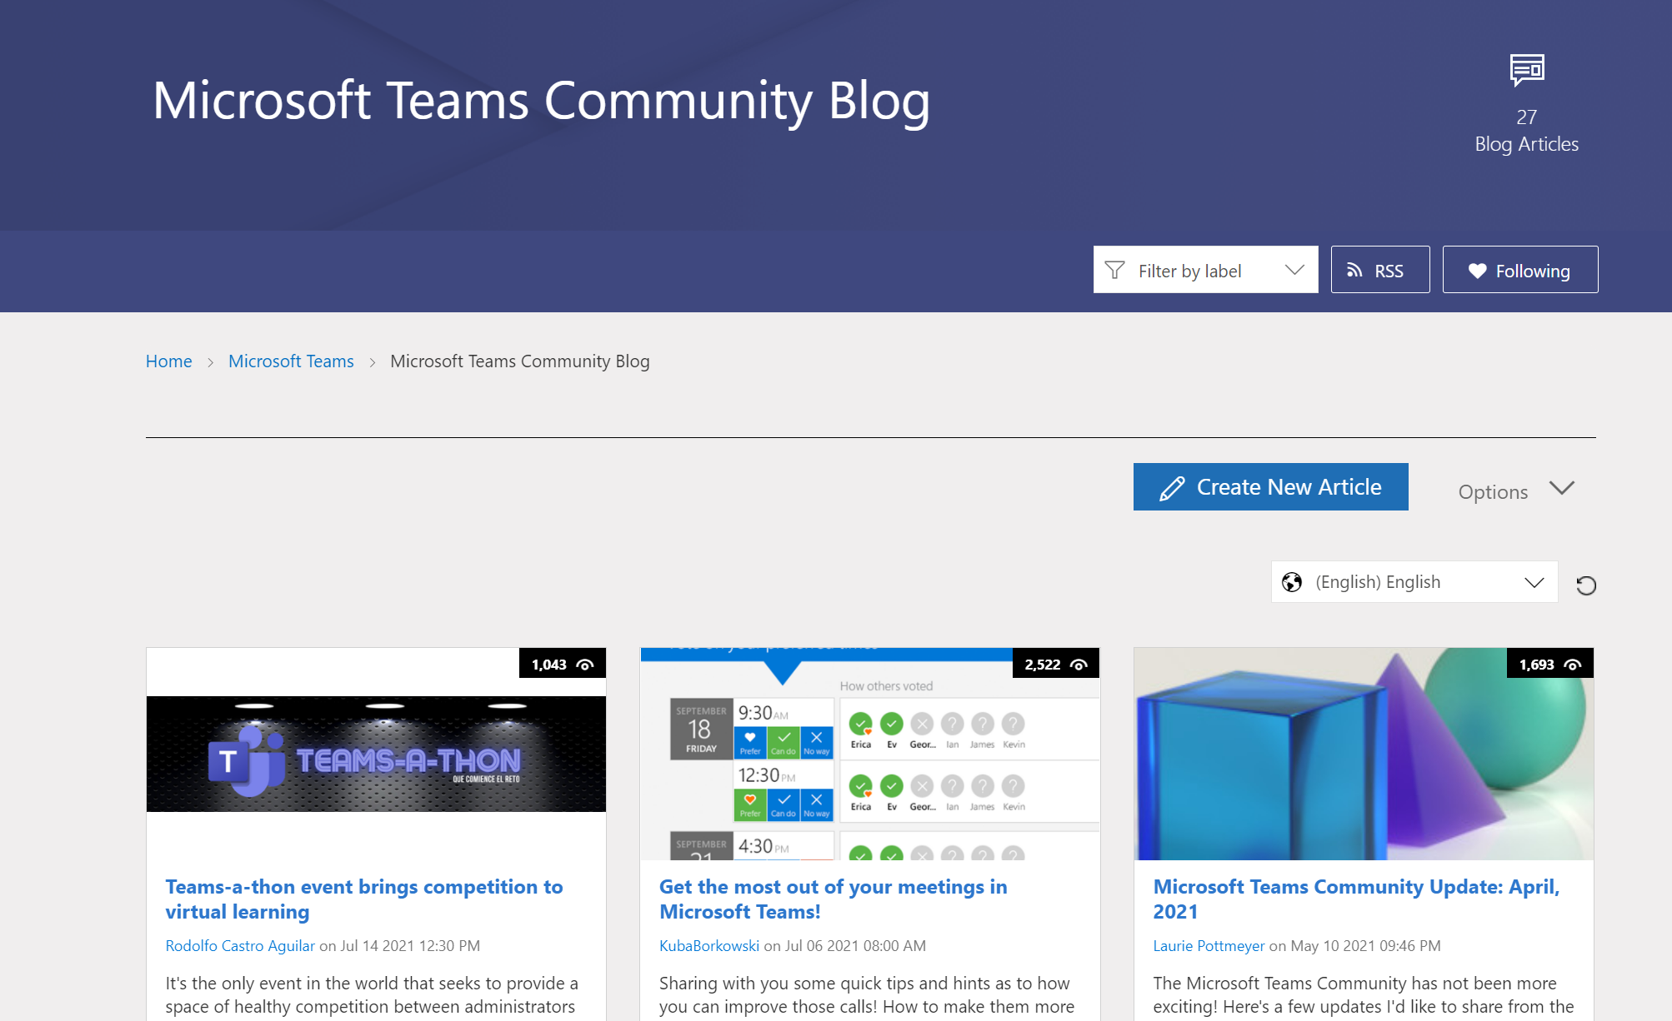
Teams Community Blog
→https://aka.ms/TeamsCommunityBlogger

Slide 59
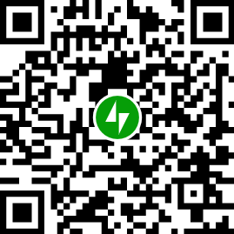
Organisatorisches
Microsoft Community Tenant für User Groups
Teilnahme als Microsoft 365 Gast
Anmeldung: https://go.granikos.eu/TeamsUGForm
Teams Meeting Teilnahme-Link
https://teamsusergroup.berlin/meetup
Teams User Group Aufzeichnungen
https://teamsusergroup.berlin/video

Slide 60
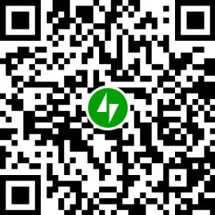
Vielen Dank für eure Teilnahme!
Das nächste Meetup:
→ 7. Dezember 2023
https://TeamsUserGroup.Berlin/register
Spread the Word!
#TeamsUGBerlin
Aufzeichnungen unserer Meetups sind im Community Team und bei YouTube verfügbar.

Slide 61
Offene Diskussion

